Slide 1
AMST 140 Washington: Life inside a Monument
Week 11 - Latino Washington

Slide 2
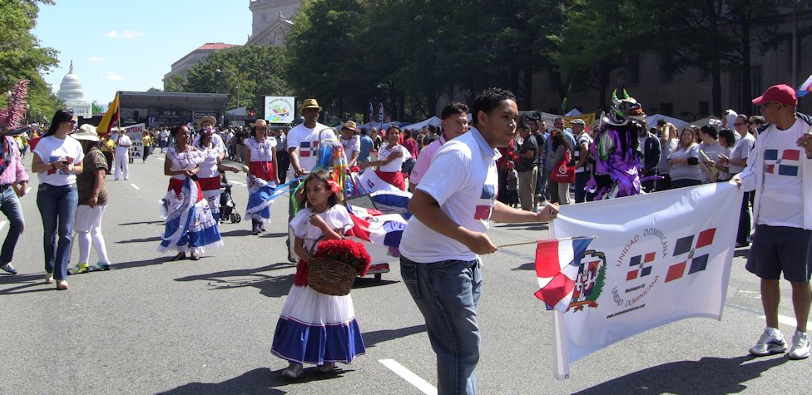
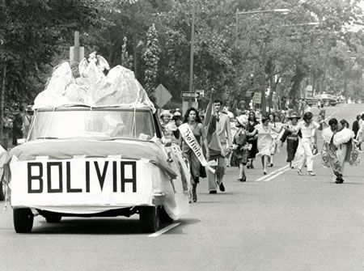
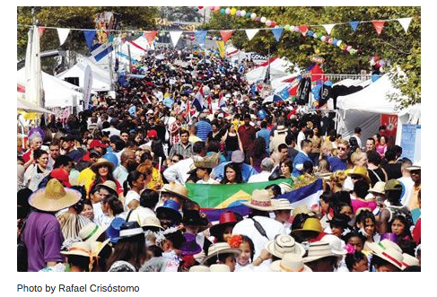
Latin Washington
FIesta DC September 2012, Washington, DC
The Bolivian float and marchers head down 16th Street, NW, during the 1977 Hispanic American Festival parade. Photo from the Star Collection, DC Public Library, © Washington Post
Fiesta DC, Near Farragut West, Washington, DC 2014
Notes:
Photo source: https://www.huffpost.com/entry/latino-festival-fiestadc-_b_1911583?guccounter=1&guce_referrer=aHR0cHM6Ly93d3cuZ29vZ2xlLmNvbS8&guce_referrer_sig=AQAAAKjyQj7MFvkW2GQJE6ttWnpr-ATOzuiQfzg1HWEmiWABcq276utLTAA77LK9ZeKe-nAcmDaT2UnGJq56qHHIhwcN1M1nRwTgpW1runtVzXjUtouBZh0loyw30XIVOltfn43E1BQ1LSxgic5pyjwKRD2b1aIO5E-zAoE_ybaZAnk_
https://www.arts.gov/NEARTS/2010v2-arts-capital/vamos-la-calle

Slide 3
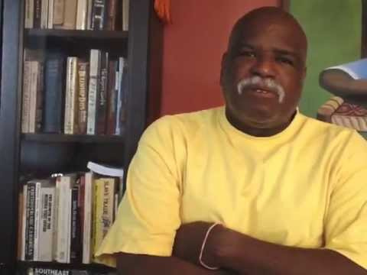
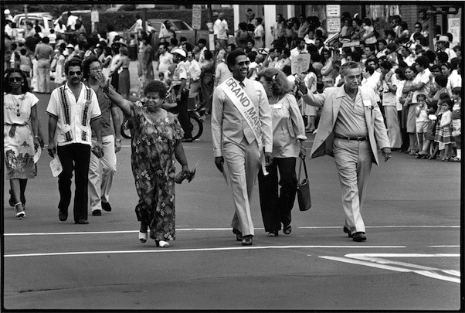
DC’s Latino Community: Diverse Origins
Carlos Rosario + other leaders march in the 1981 Hispanic Festival parade. © Rick Reinhard
Learn more here:
https://www.holacultura.com/the-1970s-latinos-assert-presence-and-political-clout/
Notes:
Photo and film source: https://www.holacultura.com/the-1970s-latinos-assert-presence-and-political-clout/

Slide 4
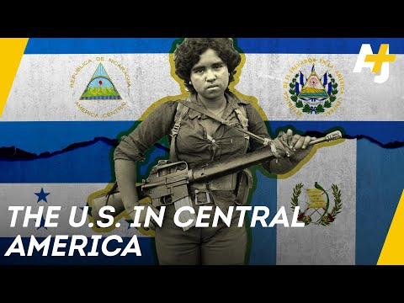
DC’s Latino Community: Flights & Formations
This video covers a lot of stuff, but focus on the following for your notes:
How did the United States interventions in Latin American countries affect them in general?

Slide 5
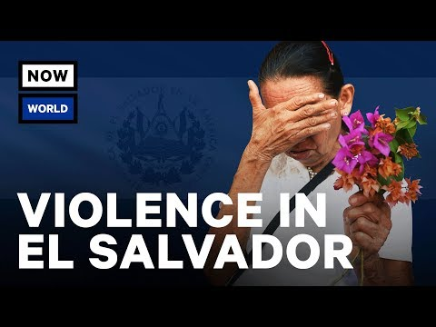
DC’s Latino Community: Flight & Formations

Slide 6
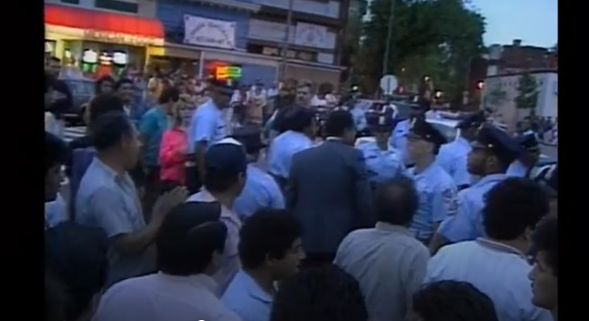
Mount Pleasant Rebellion of 1991
Listen:
https://wamu.org/story/11/05/05/mount_pleasant_riots_may_5_woven_into_neighborhoods_history/
Watch:
https://www.pbs.org/video/mount-pleasant-riots-q9kocq/
https://mediaburn.org/video/the-90s-48/ (Watch from 0:00 to 14:18)
Notes:
Photo Source: screenshot https://www.pbs.org/video/mount-pleasant-riots-q9kocq/

Slide 7
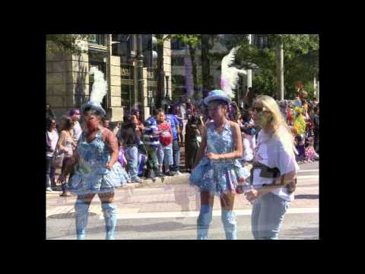
Cultural Flourishing
Watch:
Note the diversity of culture featured in this 2012 Fiesta DC celebration.

Slide 8
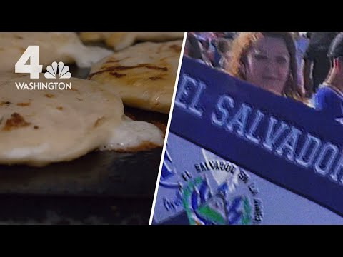
Cultural Flourishing
For your notes:
Why is food so important to Salvadoran culture in DC?
How is Salvadoran food culture reshaping DC?

Slide 9
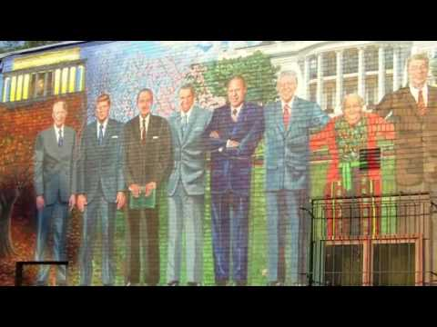
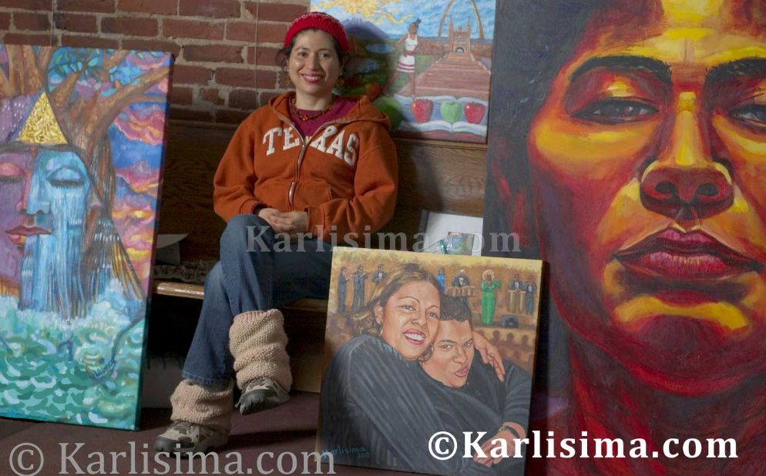
Cultural Flourishing
Visit the follow website and read Karlisima’s biographical statement: https://karlisima.com/about/biography/
Then explore the work of this DC artist: https://karlisima.com/gallery/murals/
Have you seen any of her murals around the city before? What does her body of art communicate to you?

Slide 10
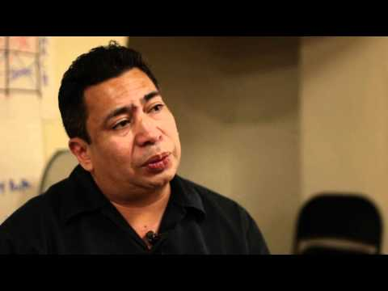
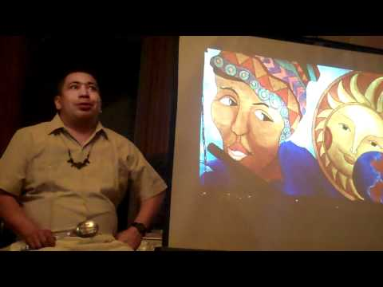
Life as Wachintonians
Watch: Quique Avilés discuss his life and work. Then, watch a live performance as he dramatizes a Salvadoran life in Washington.

Slide 11
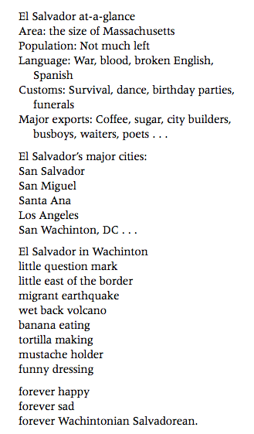
“El Salvador At-A-Glance”
For your notes:
What is Quique Avilés’s poem excerpt saying about
1) El Salvador
2) Washington, DC and
3) Salvadorans in Washington?

Slide 12
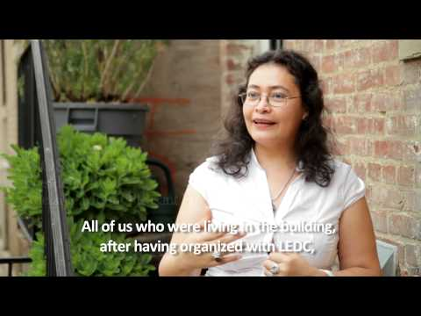
Latino Neighborhood Development
For your notes:
How does this video clip showcase new opportunities AND ongoing challenges for Latino Americans in and near DC?

Slide 13
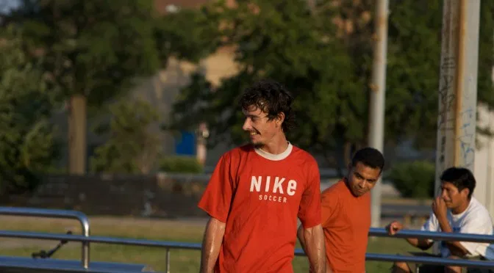
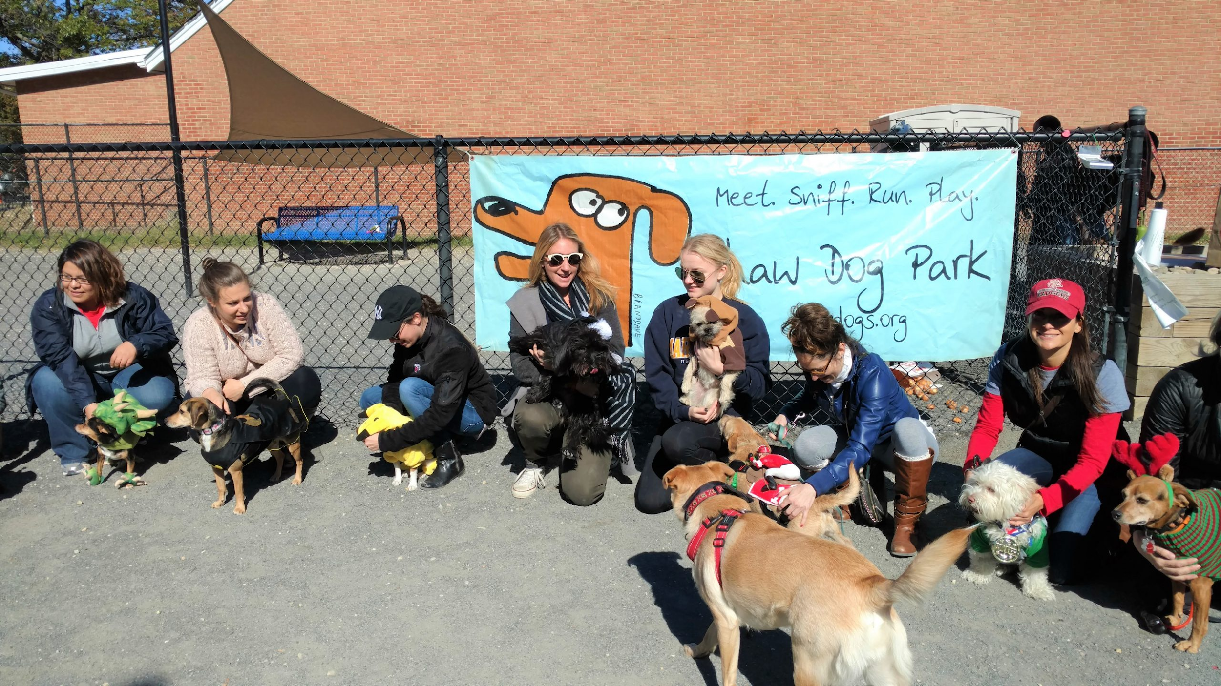
How a dog park becomes an elite space
Dog Park Saga Extended
Read: https://wamu.org/story/20/03/05/no-mans-or-dogs-land-d-c-s-shaw-dog-park-will-close-until-fall-2021/
For your notes:
Why do you think the city never replaced the soccer canchita after destroying it for a dog park?
How is a dog park a subtle means of pushing people out of a neighborhood?
Photo of players at Shaw “La Canchita” before its destruction
Photo of Shaw Dog Park in Fall 2020
Notes:
Photo source: https://midcitydcnews.com/2020/02/29/shaw-park-to-close-for-year-in-april/
Photo source: http://www.tonitileva.com/2016/03/14/department-of-parks-and-gentrification-a-tale-of-dogs-and-men-at-the-shaw-dog-park/

Slide 14
